Slide 1
ACCUMULATOR UNIT
Purpose
To design an efficient multiplier and Accumulator (MAC) unit to do operations like multiplication & addition on numbers stored in RAM unit attached to it.
By: Ayush Gupta

Slide 2
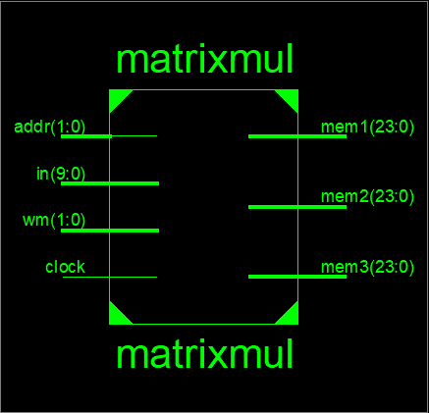
BLOCK DIAGRAM
EXPECTED FUNCTIONALITY
RAM
Read
Write
Modified Booth Multiplier
Carry Look Ahead Adder

Slide 3
IMPLEMENTED FUNCTIONALITY
There is 4:1 Mux used in this case whose control signal is 2-bit wide signal “wm” (shown in block diagram).
If wm = 2’b00, then the memory will be written at the address provided by in value.
If wm = 2’b01, then the read operation at the provided address is performed on the unit and the result can be seen at the output port mem1.
If wm = 2’b10, then the multiplication of two numbers stored in the memory is performed result can be seen at port mem3.
If wm = 2’b11, then the addition of two numbers stored in the memory is performed and result can be seen at port mem2.

Slide 4
VERILOG FEATURES EMPLOYED
Blocking Statements Assignment of right hand value to the left hand variable is done immediately. These statements comes under Active Queue.
Fork/Join All statements written between these two statements executes in parallel.
Repeat Self checking test bench generates random values for the input and checks for the mismatch of calculated and expected value of output. For implementing this functionality repeat statement is used which continues to assign the values to the inputs for a mentioned number of time.

Slide 5
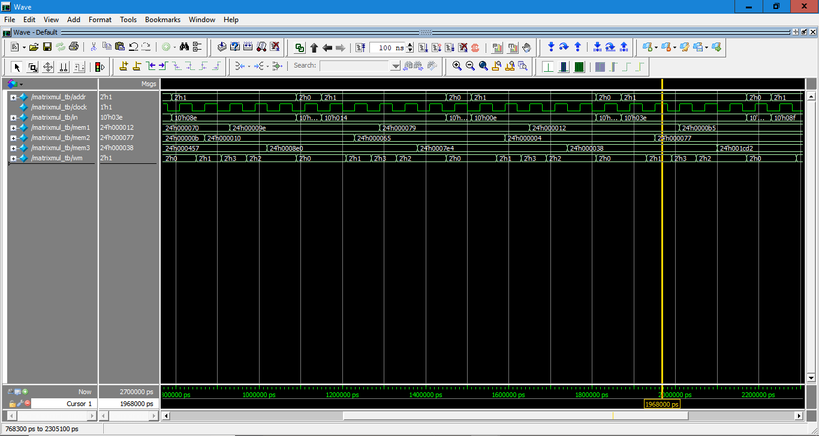
WAVEFORM

Slide 6
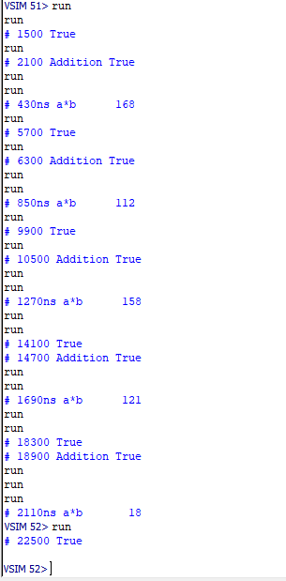
TRANSCRIPT

Slide 7
AREA REPORT
Minimum period: 0.682ns (Maximum Frequency: 1467.136 MHz)
Minimum input arrival time before clock: 1.892ns
Maximum output required time after clock: 2.826ns
Maximum combinational path delay: No path found
Setup time = 1.892 ns
Hold time = 2.826 ns

Slide 8
COMMENT
Functionality implemented are:
Memory read/write
Multiplier
Adder
The functionalities which was expected are implemented successfully.
Modified Booth technique is used to multiply the numbers which is the efficient techniques in terms of number of clock cycles consumed in multiplication.
For addition of two numbers Carry Look Ahead type of Adders are used which is also the most efficient type of adder in terms of time consumed for the addition of two numbers.

Slide 9
FUTURE SCOPE
Used for high-end process where faster computations (Hardware Accelerators) are needed e.g.,
Deep learning Algorithms
Cryptography
Artificial Intelligence computations
Gaming Consoles

Slide 10
THANK YOU

